Slide 1
COVIBLOCK: A Merkle DAG and Blockchain Implementation for COVID-19 Records
Presented by: Jennifer L. Fadriquela

Slide 2
Objectives
To develop an application that will decentralize storage of COVID-19 related files.
1
To provide an alternative way to minimize record tampering of uploaded files in CoviBlock by applying concepts of Merkle DAG and Proof of Authority (PoA) blockchain.
2
3
To secure uploaded files in CoviBlock by using asymmetric cryptography.

Slide 3
Blockchain
A technology that permits a network of computers to have a consensus on the true status of a distributed ledger at regular intervals.

Slide 4
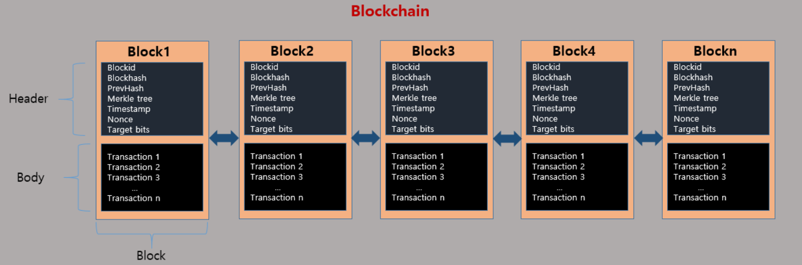
Blockchain
A chain of blocks, blocks are like tables in the database, but they cannot be deleted or updated, blocks contain information. The blocks are cryptographically verified and chained up to form an immutable chain of blocks called a blockchain or ledger.
Notes:
https://medium.com/swlh/is-it-hard-to-build-a-blockchain-from-scratch-2662e9b873b7

Slide 5
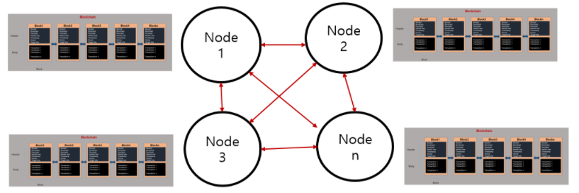
Blockchain
The same chain is then distributed to all the nodes (computers or miners) across the network via a P2P network.

Slide 6
Blockchain
Below are main features of a blockchain: Decentralization: Instead of relying on a single trusted entity, trust is spread across multiple or all participants, depending on the agreed-upon consensus algorithm.
Immutability: Once data is committed to the blockchain and enough participants have agreed on this state, the information is stored permanently and immutably.
Scalability: The block rate, comprised of the throughput and propagation time of information, depends on the consensus algorithm and the number of participants.
Limited privacy: All data in the blockchain is publicly visible to all participants. Private or permissioned blockchains limit the range of disclosure.
Notes:
https://jis-eurasipjournals.springeropen.com/articles/10.1186/s13635-019-0085-3
Decentralization: Instead of relying on a single trusted entity, trust is spread across multiple or all participants, depending on the agreed-upon consensus algorithm [10]. This does not only mean that multiple copies of a data item are stored on all nodes, but also that the integrity of the data is governed by many decentralized parties.
Immutability: Once data is committed to the blockchain and a sufficient number of participants have agreed on this state, the information is stored permanently and immutably. Changing the information contained in a particular block would require to also change all the following blocks up to the last block, which is considered to be infeasible [1, 11].
Scalability: The block rate, comprised of the throughput and propagation time of information, depends on the consensus algorithm and the number of participants. This can be a limiting factor for applications that require high throughput [10]. Since all nodes hold a copy of the blockchain, scalability issues also arise in terms of the total amount of data that can be stored. Furthermore, in order to check the integrity of the blockchain, a new node needs to download a copy and validate the integrity of the entire chain. Note that more recent proposals for BFT-based consensus algorithms improved on this, e.g., [12].
Limited privacy: All data in the blockchain is publicly visible to all participants. Private or permissioned blockchains limit the range of disclosure. However, they do not cryptographically protect the data. In order to achieve privacy, additional layers, such as zero-knowledge proofs [13] or a commitment scheme are required [14].

Slide 7
Proof of Authority
A set of trusted nodes called Authorities, each recognized by their unique identifier, are responsible for mining and validating the blocks in the blockchain.

Slide 8
Proof of Authority
Clique is a type of consensus protocol referred to as the Proof of Authority (or PoA for short).
In a PoA consensus algorithm, a set of trusted nodes known as Authorities, each identified by their unique identifier, are responsible for mining and validating the blocks in the blockchain.
Each block is produced by an authority at a fixed interval. The responsibility of creating the next block is shared amongst the set of authorities and is done in a round-robin fashion.

Slide 9
Proof of Authority
The Clique consensus protocol adheres to the following rules:
- Set of trusted authorities are referred to as the "Signers"
- Process of mining a block is referred to as "Sealing a block"
- WHEN the next block is identified by BLOCK_NUMBER and the number of signers is identified by SIGNER_COUNT
- AND the signers are lexicographically sorted by their unique identifiers in a list
- THEN the next block is sealed by the signer located at the index
- BLOCK_NUMBER % SIGNER_COUNT, where % is the modulus operator

Slide 10
IPFS
A distributed platform for storing and retrieving files, websites, applications and data.

Slide 11
IPFS – Content Addressing
IPFS uses content addressing to identify content by what's in it rather than by where it's located.
Right now, content is found by location, such as:
- https://en.wikipedia.org/wiki/Aardvark
- /Users/Alice/Documents/term_paper.doc
- C:\Users\Joe\My Documents\project_sprint_presentation.ppt
IPFS uses content addressing the way HTTP uses URLs. This means that instead of creating identifiers that address artifacts by location, we can address them by some representation of the content itself.
Notes:
https://blog.infura.io/an-introduction-to-ipfs/

Slide 12
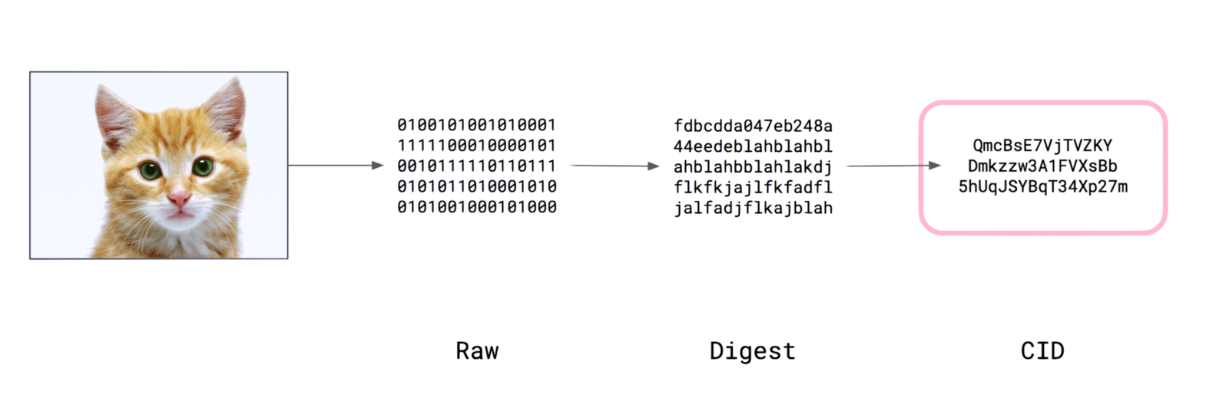
IPFS – Content Addressing
Notes:
https://blog.infura.io/an-introduction-to-ipfs/

Slide 13
IPFS – Merkle DAG
A Merkle DAG is a DAG where each node has an identifier, and this is the result of hashing the node's contents — any opaque payload carried by the node and the list of identifiers of its children — using a cryptographic hash function like SHA256.
- Merkle DAGs can only be constructed from the leaves, that is, from nodes without children.
- Every node in a Merkle DAG is the root of a (sub)Merkle DAG itself, and this subgraph is contained in the parent DAG.
- Merkle DAG nodes are immutable.

Slide 14
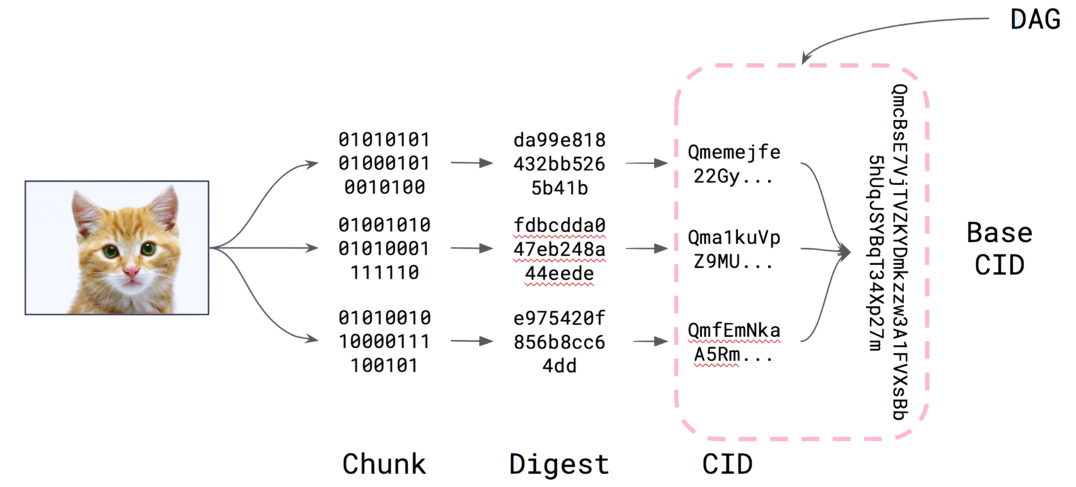
IPFS – Merkle DAG

Slide 15
IPFS – Distributed Hash Table
To find which peers are hosting the content you're after (discovery), IPFS uses a distributed hash table, or DHT.
A hash table is a database of keys to values. A distributed hash table is one where the table is split across all the peers in a distributed network. To find content, you ask these peers.
The libp2p project is the part of the IPFS ecosystem that provides the DHT and handles peers connecting and talking to each other

Slide 16
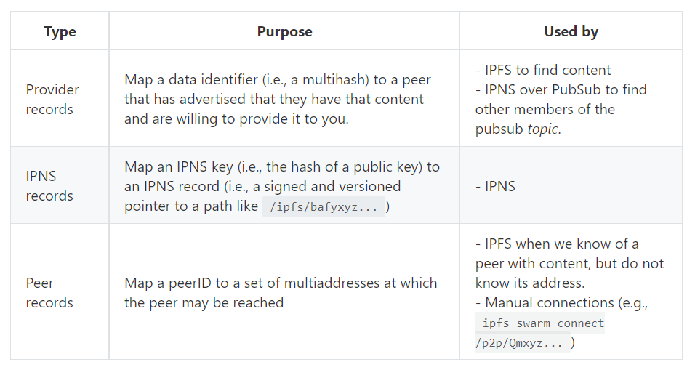
IPFS – Distributed Hash Table
There are three types of key-value pairings that are mapped using the DHT:

Slide 17
Asymmetric Cryptography
Process that uses a pair of related keys to encrypt and decrypt a message and protect it from unauthorized access or use.

Slide 18
Asymmetric Cryptography
The two participants in the asymmetric encryption workflow are the sender and the receiver; each has its own pair of public and private keys.
- First, the sender obtains the receiver's public key.
- Next, the plaintext is encrypted by the sender using the receiver's public key; this creates ciphertext.
- The ciphertext is then sent to the receiver, who decrypts the ciphertext with their private key and returns it to legible plaintext.
Because of the one-way nature of the encryption function, one sender is unable to read the messages of another sender, even though each has the public key of the receiver.
Notes:
https://searchsecurity.techtarget.com/definition/asymmetric-cryptography

Slide 19
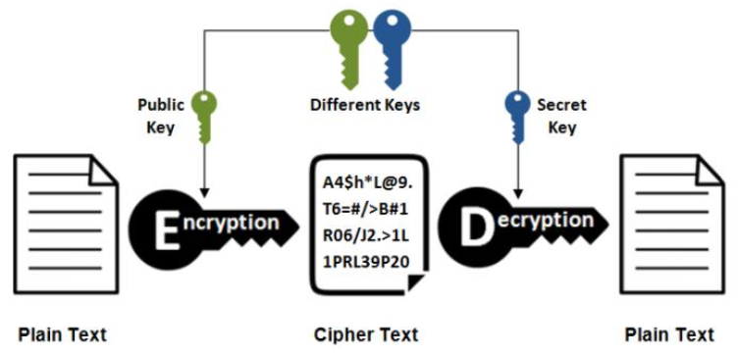
Asymmetric Cryptography
Notes:
https://searchsecurity.techtarget.com/definition/asymmetric-cryptography

Slide 20
DO NOT TOUCH FROM HERE

Slide 21
Difference between cryptocurrency
and stocks
Here is where your presentation begins

Slide 22
Contents of this template
Here’s what you’ll find in this Slidesgo template:
A slide structure based on a presentation for business, which you can easily adapt to your needs. For more info on how to edit the template, please visit Slidesgo School or read our FAQs.
An assortment of graphic resources that are suitable for use in the presentation can be found in the alternative resources slide.
A thanks slide, which you must keep so that proper credits for our design are given.
A resources slide, where you’ll find links to all the elements used in the template.
Instructions for use.
Final slides with:
The fonts and colors used in the template.
A selection of illustrations. You can also customize and animate them as you wish with the online editor. Visit Storyset to find more.
More infographic resources, whose size and color can be edited.
Sets of customizable icons of the following themes: general, business, avatar, creative process, education, help & support, medical, nature, performing arts, SEO & marketing, and teamwork.
You can delete this slide when you’re done editing the presentation.

Slide 23
Agenda
1
2
Objectives
Timeline
3
4
Schedule
Report
Describe the topic of the section here
Describe the topic of the section here
Describe the topic of the section here
Describe the topic of the section here

Slide 24
1
Meeting objectives
You can enter a subtitle her if you need it

Slide 25
About the project
Do you know what helps you make your point clear?
Lists like this one:
They’re simple
You can organize your ideas clearly
You will never forget to buy milk!
And the most important thing: the audience will not miss any point of your presentation

Slide 26
Introduction
You can give a brief description of the topic you want to talk about here. For example, if you want to talk about Mercury, you could say that it’s the smallest planet in the entire Solar System

Slide 27
Meeting objectives
Expose progress
Distribute tasks
Clear the future
Venus is the second planet from the Sun
Jupiter is the biggest planet of them all
Despite being red, Mars is a cold place

Slide 28
Project schedule
Phase 1
Phase 2
January
February
March
April
May
Task 1
Task 2
Task 1
Task 2

Slide 29
—Someone Famous
“This is a quote, words full of wisdom that someone important said and can make the reader get inspired.”

Slide 30
Strategy checklist
 | Strategy 1 | Strategy 2 | Strategy 3
You can describe here your task
You can describe here your task
You can describe here your task

Slide 31
Project timeline
Week 2
Week 4
Week 1
Week 3
Week 5
Mars is actually a cold place
Saturn has several rings
Venus has a beautiful name
Jupiter is the biggest planet
Saturn is the ringed planet

Slide 32
KPI dashboard
People
Budget
Sales
Market
60%
Venus has a beautiful name
Advantage price per unit
$35.28
80%
60 days
Advantage days on market
Jupiter is the biggest planet
25 shops
Retailers and wholesalers
25%
Mars is actually a cold place
500 units
Remaining inventory

Slide 33
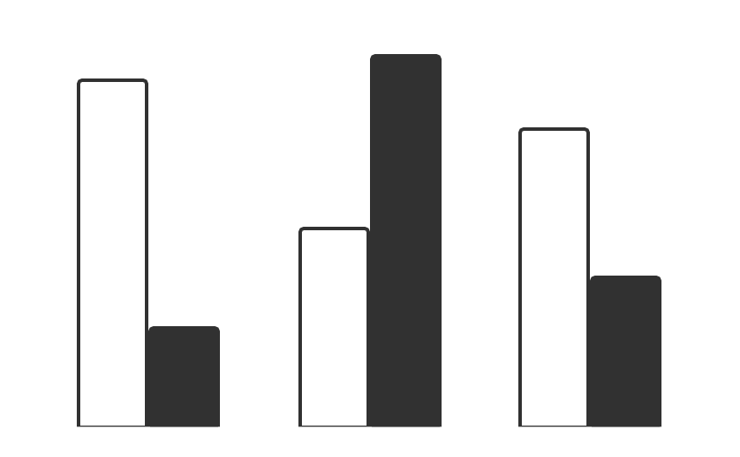
Advantages
75%
70%
60%
Stock
Neptune is the farthest planet
40%
30%
20%
Cryptocurrency
Mars is actually a cold place
Follow the link in the graph to modify its data and then paste the new one here. For more info, click here

Slide 34
Status report
Schedule
The project schedule is on track
Resourcing
Resourcing is adequate
Budget
Project is within budget
Risks
Almost all risks are under control
Issues
Project issues need to be solved
Benefits
Benefits do not meet the expectations

Slide 35
RAID summary
Risks
Assumptions
Issues
Dependencies
Neptune is the farthest planet in the Solar System. It’s the fourth-largest by diameter
Despite being red, Mars is actually a cold place. It’s full of iron oxide dust
Mercury is the closest planet to the Sun and the smallest one in the Solar System
Jupiter is the biggest planet in the Solar System and the fourth-brightest in the sky

Slide 36
Awesome words

Slide 37
Where we are now
Where we want to be
Mercury is the closest planet to the Sun and the smallest one in the Solar System—it’s only a bit larger than the Moon
Venus has a beautiful name and is the second planet from the Sun. It’s terribly hot—even hotter than Mercury

Slide 38
Cryptocurrency vs stocks
What
you own
Operation time
Venus is the second planet from the Sun
Saturn is a gas giant and has rings
Their authority
Their volatility
Despite being red, Mars is a cold place
Mars is actually a very cold place

Slide 39



A picture is worth a thousand words

Slide 40
Upcoming events
Summit
Conference
Blockchain
19 Oct
Despite being red, Mars is a cold place
20 Dec
Mercury is the closest planet to the Sun
13 Mar
Jupiter is the biggest planet of them all

Slide 41
Whoa!
This can be the part of the presentation where you tell an interesting anecdote

Slide 42
To consider
Transactions
Globality
Transparency
Safety
Privacy
Speculation
Jupiter is the biggest planet
Venus is the second planet
Venus has a beautiful name
Saturn is a gas giant with rings
Mars is actually a cold place
Mercury is the smallest planet

Slide 43
Currency around the world
USA
Venus is the second planet from the Sun
Asia
Saturn is a gas giant and has rings
Australia
Mars is actually a very cold place

Slide 44
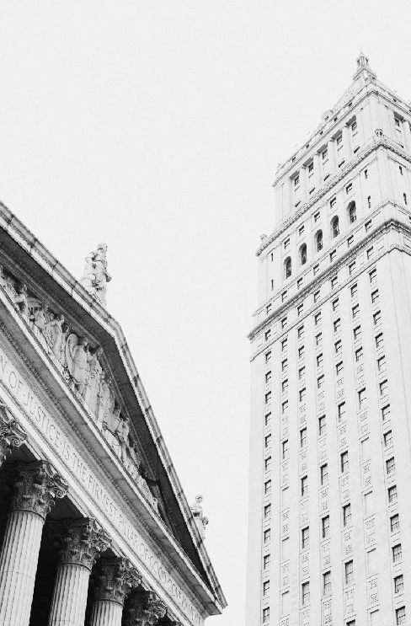

Pictures always reinforce the concept
Images reveal large amounts of data, so remember: use an image instead of a long text. Your audience will appreciate it

Slide 45
$50,000
Big numbers catch your audience’s attention

Slide 46
9H 55M 23S
333,000.000
Is Jupiter’s rotation period
Earths is the Sun's mass

Slide 47
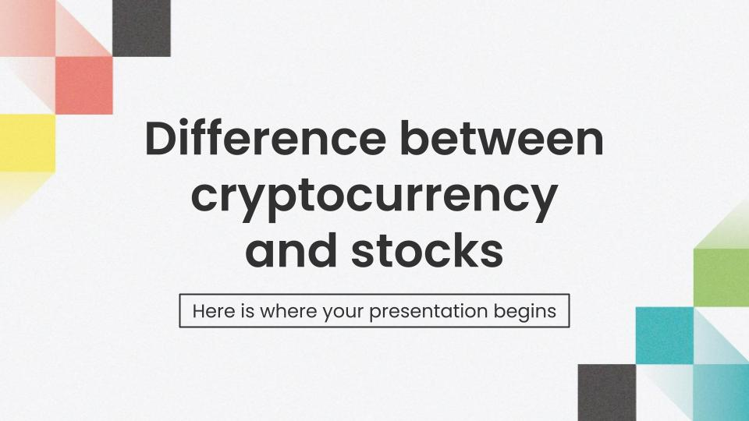
Mobile app
You can replace the image on the screen with your own work. Just delete this one, add yours and center it properly

Slide 48
Thanks!
Do you have any questions?
addyouremail@freepik.com
+91 620 421 838
yourcompany.com
Please keep this slide for attribution

Slide 49
Business icon pack

Slide 50
Blockchain icon pack

Slide 51
Alternative resources
Photos
Facade of old building with columns of new york stock exchange
New york city skyline with sun

Slide 52
Resources
Photos
Bottom view of buildings in urban environment
Vintage roof of stock exchange and tall building

